Slide 1

UAVs, Measurements and Precise Agriculture
Prof. Pasquale Daponte
Laboratory of Signal Processing and Measurement Information
daponte@unisannio.it
http://lesim1.ing.unisannio.it
Mob. +39 346 080 31 98, Ph. +39 0824305817
Dr. Fatemeh Khalesi’s thesis

Slide 2
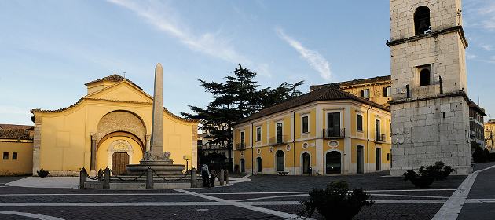

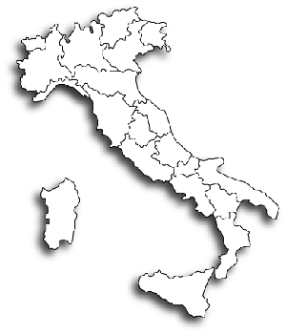

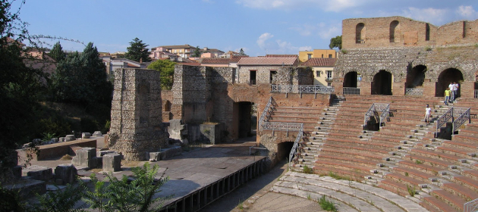
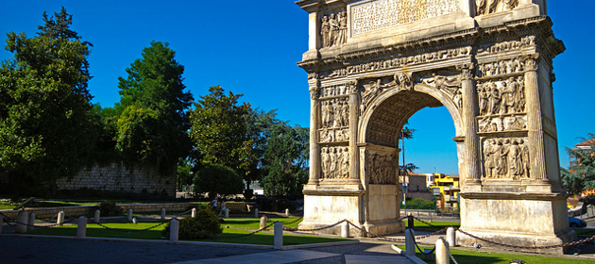
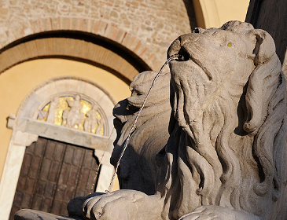
L.E.S.I.M.: Who We are
Where is Benevento?
Rome
TWICE !!
Benevento
Naples

Slide 3


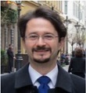
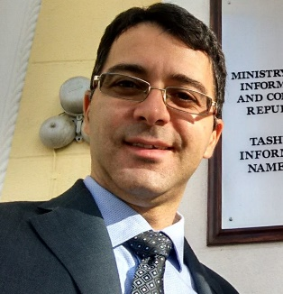
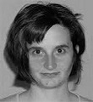

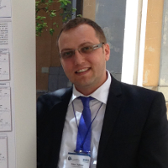



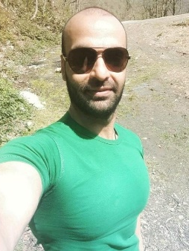
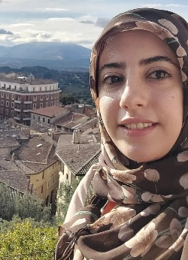

L.E.S.I.M.: Who We
Laboratory of Signal Processing and Measurement Information
Prof. Pasquale
Daponte
Prof. Sergio
Rapuano
Prof. Luca
De Vito
Prof. Eulalia
Balestrieri
Prof. Francesco
Picariello
Prof. Ioan
Tudosa
Dr. Gianluca
Mazzilli
(Researcher)
Dr. Liliana
Viglione
(Researcher)
Dr. Enrico
Picariello
(Ph.D. student)
Dr. Arman
Neyestani
(Ph.D. student)
Dr. Fatemeh
Khalesi
(Ph.D. student)
Dr. Martina
Imbriglia
(Ph.D. student)

Slide 4
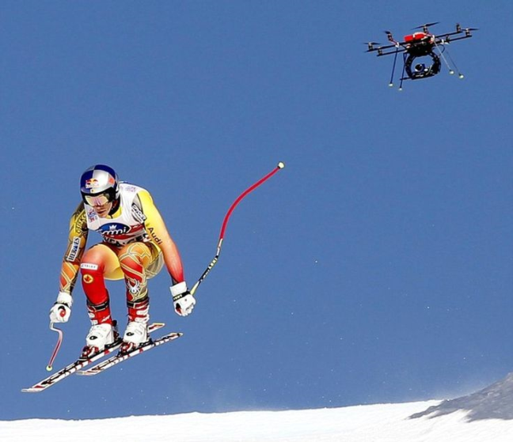
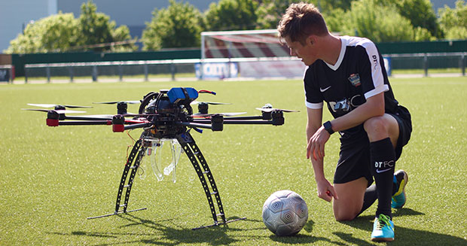
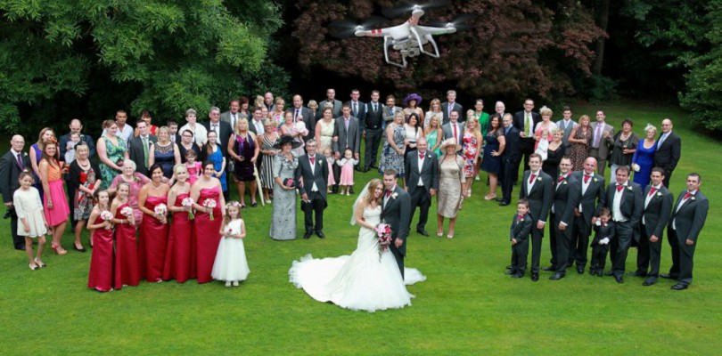
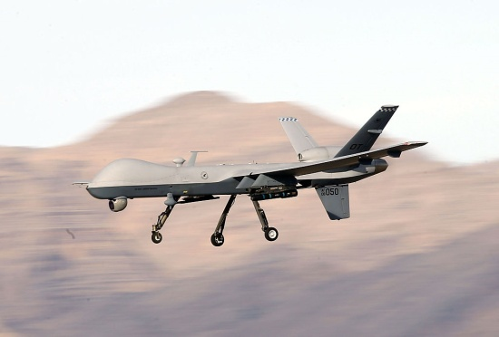
Unmanned Aerial Vehicles (UAVs) (1/2)
What are UAVs? …for others…
UAV is for making pictures;
UAV is for military missions;
UAV is a toy.

Slide 5
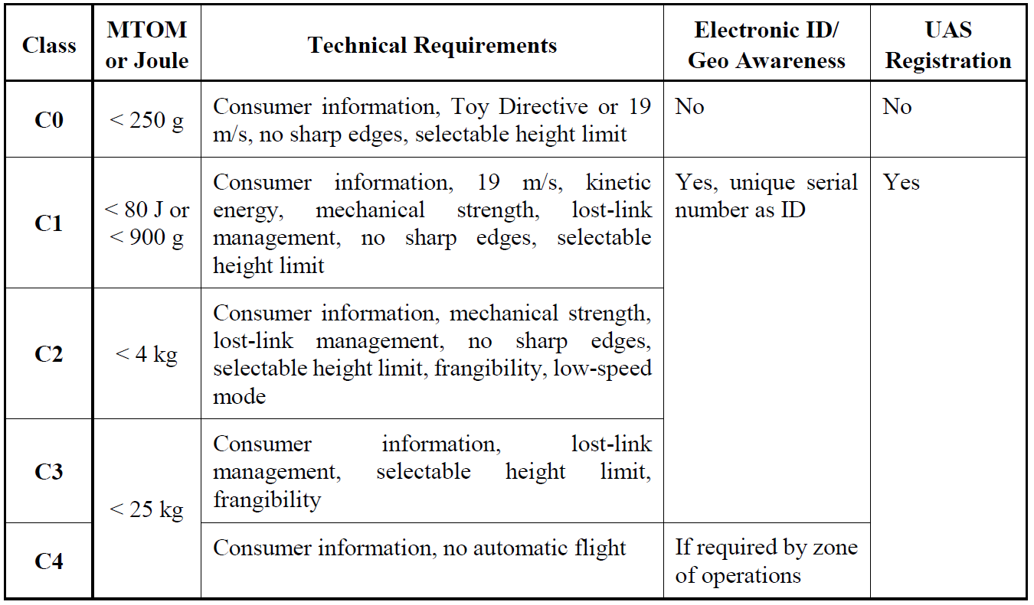
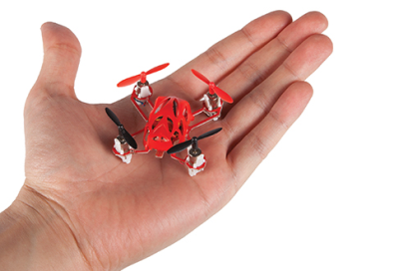
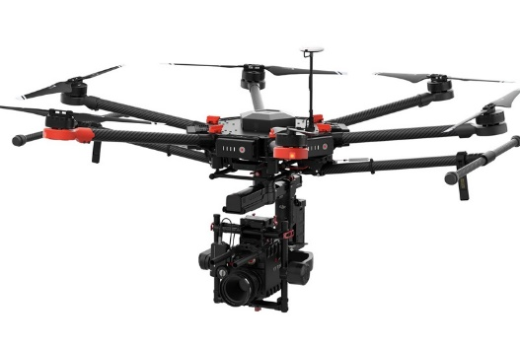
UAVs (2/2)
What are UAVs? …literature…
“An Unmanned Aircraft System (UAS) comprises individual system elements consisting of unmanned aircraft, the control station and any other system elements necessary to enable flight, i.e. command and control link and launch and recovery elements.”
European Aviation Safety Agency (2009)
MTOM: Maximum Take-off Mass

Slide 6

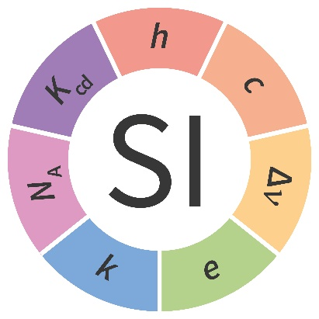
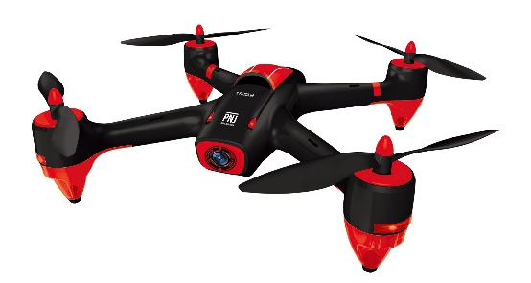
Measurements for UAV and UAV for measurements
A UAV needs to take the measurements provided by several sensors for flying;
In several applications, the sensors embedded on the UAV are used for taking measurements during flight.
UAV
Measurements

Slide 7

Measurements for UAV and UAV for measurements
UAV
How to evaluate the uncertainties when we are measuring by means of a UAV ?
Measurements

Slide 8
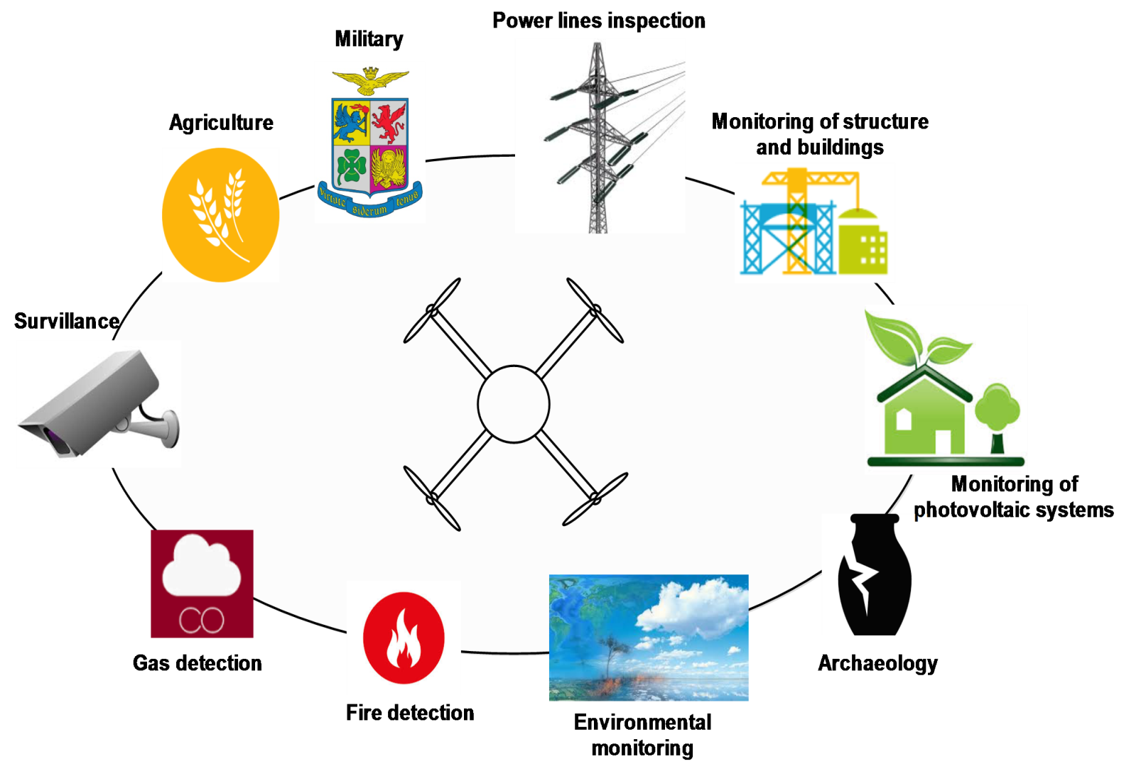
UAV fields of applications

Slide 9

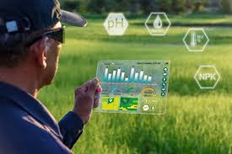
Challenges in Agriculture
Challenges
Global population expected to reach 9.7 billion by 2050
Increasing demand for food and fiber at unprecedented rates
Traditional agriculture faces resource limitations and environmental challenges
Limited water, arable land, and energy resources
Impact of climate change: droughts, extreme weather, pests
Inefficient use of fertilizers, pesticides, and irrigation
Precision Agriculture
Precision Agriculture (PA) enhances productivity and sustainability
Uses advanced technologies for monitoring soil, crops, and environment
To provide, process, and analyze multisource data with a high spatial and temporal resolution
Enables optimized use of water, nutrients, and chemicals
Helps reduce environmental impact and climate vulnerability

Slide 10
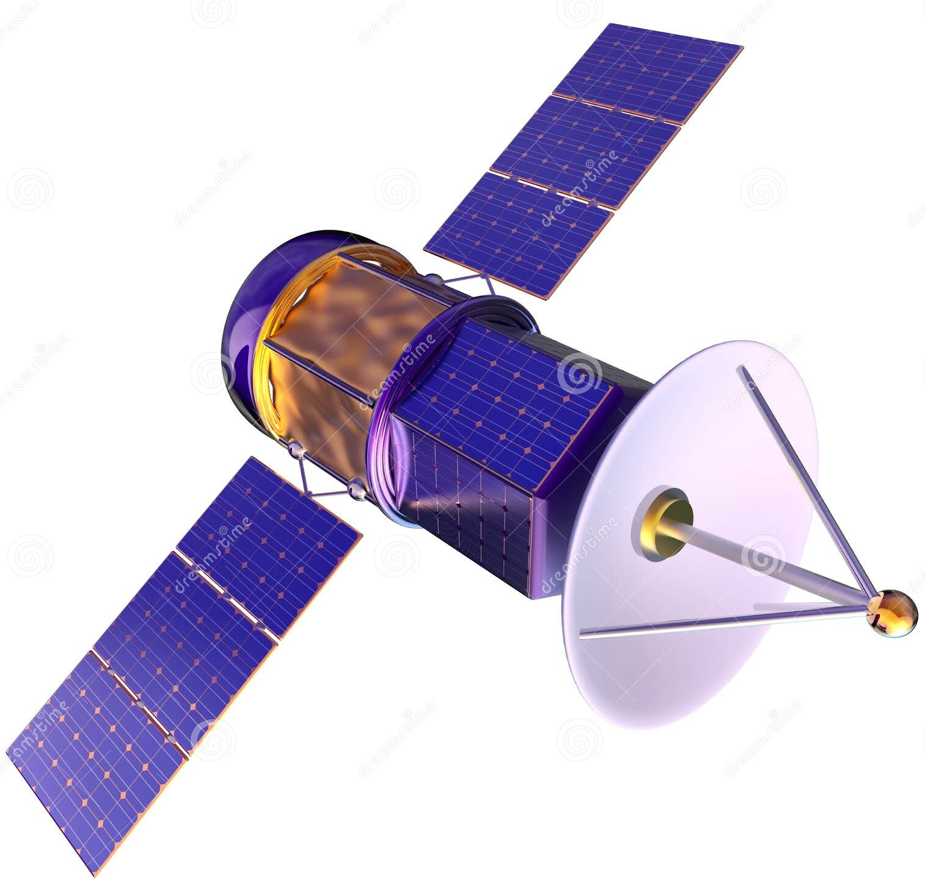
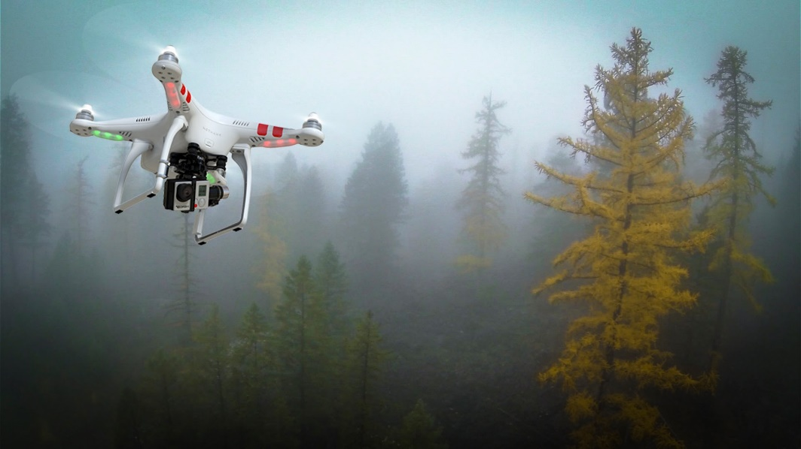
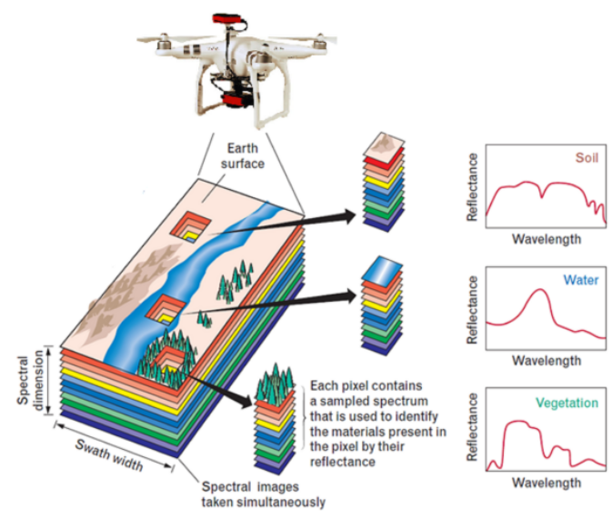
UAV and Precision Agriculture:
Challenges in Agriculture
Compared to satellites, UAVs offer superior spatial resolution and adaptability for tasks such as irrigation, fertilization, and yield prediction.
UAVs with RGB, multispectral, hyperspectral, and thermal sensors have revolutionized PA by enabling high-resolution, costeffective, and flexible crop monitoring.
Multispectral imaging allows the calculation of vegetation indices (VIs) like the Normalized Difference Vegetation Index (NDVI), Normalized Difference Moisture Index (NDMI), and Crop Water Stress Index (CWSI), which are essential for assessing plant health, stress, and water status.

Slide 11



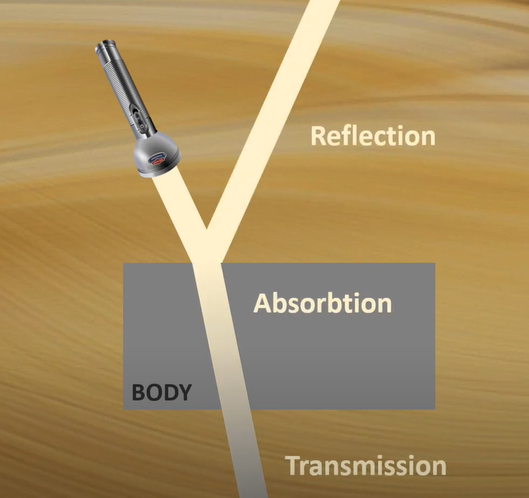
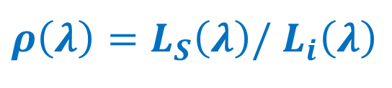

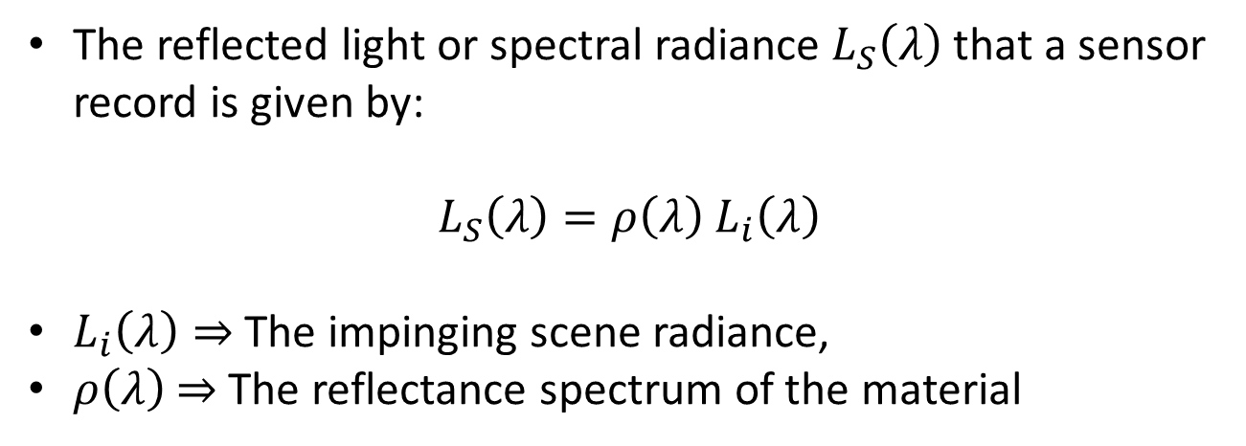



Spectral Imaging for UAVs
The reflected light or spectral radiance $L_{S}\left(λ\right)$ that a sensor record is given by:
$L_{S}\left(λ\right)=ρ\left(λ\right)$ $L_{i}\left(λ\right)$
$L_{i}\left(λ\right)⇒$The impinging scene radiance,
$ρ\left(λ\right)$ $⇒$ The reflectance spectrum of the material
$$L_{i}\left(λ\right)$$
$$L_{S}\left(λ\right)$$
➔By knowing $L_{i}\left(λ\right)$and measuring $L_{S}\left(λ\right)$:
The reflectance spectrum can be recovered
${ρ\left(λ\right)=L}_{S}\left(λ\right)/$ $L_{i}\left(λ\right)$
$$ρ\left(λ\right)$$

Slide 12
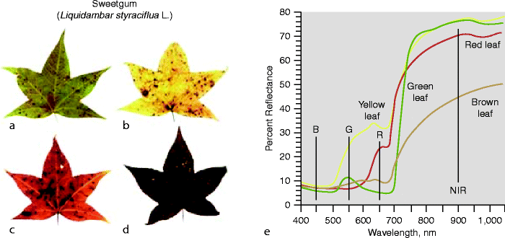
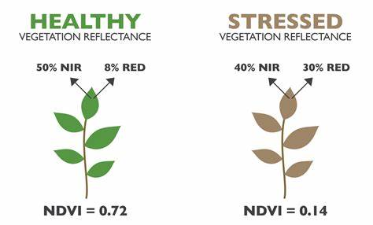
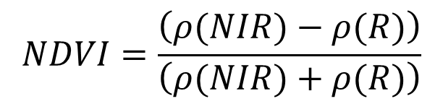

Leaf Spectrum
Normalized Difference Vegetation Index
Plants absorb solar radiation in different bands, i.e., different frequency ranges and wavelengths, and re-emits a different percentage in each. The percentage of radiation re-emitted in specific bands, such as near-infrared (NIR), red (RED), indicates the plant's health or water stress.
$$NDVI=\frac{\left(ρ(NIR)−ρ(R)\right)}{\left(ρ(NIR)+ρ(R)\right)}$$
$$ρ\left(λ\right)$$
https://www.unoosa.org/documents/pdf/psa/activities/2014/trieste-gnss/38.pdf

Slide 13
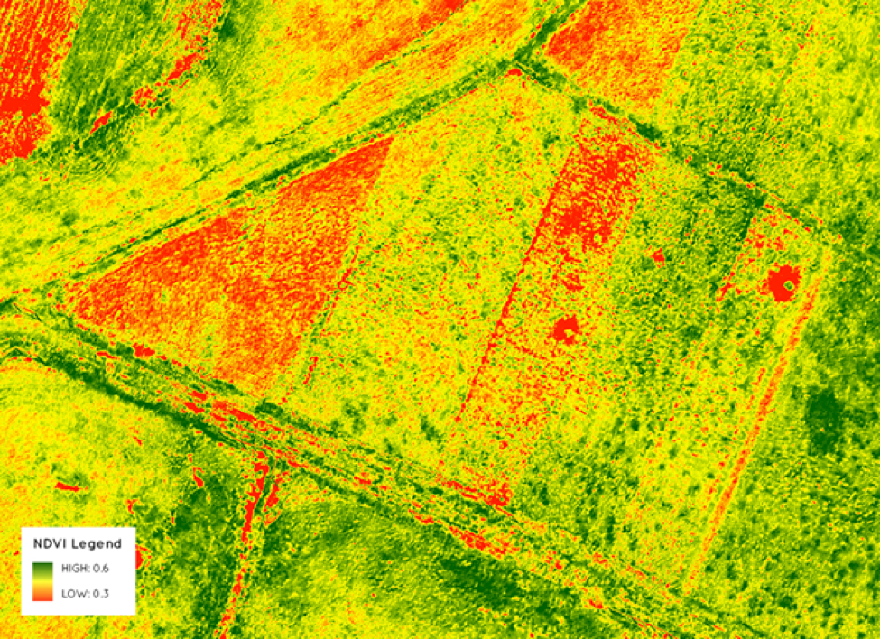
Challenges in Agriculture
Most surveys are only interested in comparing NDVI values of the same field, acquired in a single survey or in a short period of time with the same atmospheric conditions.

Slide 14
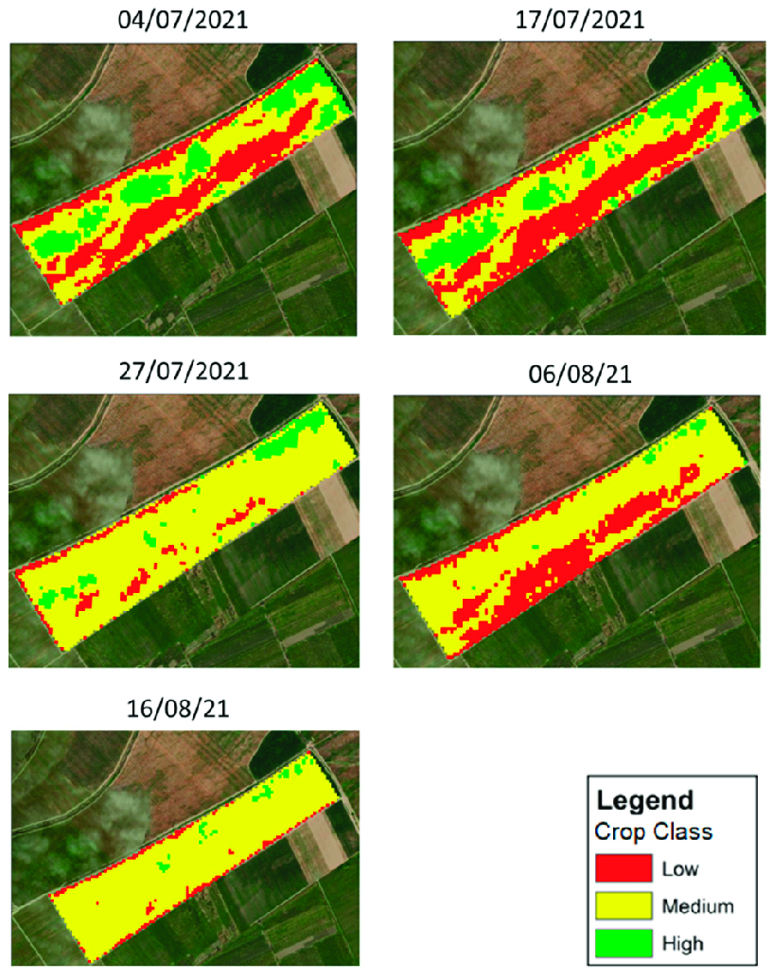
Example of the NDVI maps
Example of the NDVI maps generated throughout the cultivation season in the respective data collection dates for a single field, in quantile classification using all Khachmaz pilot fields.
Psiroukis, V.; Darra, N.; Kasimati, A.; Trojacek, P.; Hasanli, G.; & Fountas, S. (2022). Development of a Multi-Scale Tomato Yield Prediction Model in Azerbaijan Using Spectral Indices from Sentinel-2 Imagery. Remote Sensing, 14(17), 4202.
https://doi.org/10.3390/rs14174202

Slide 15
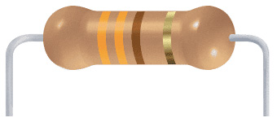
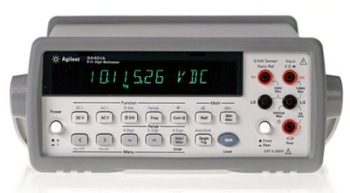
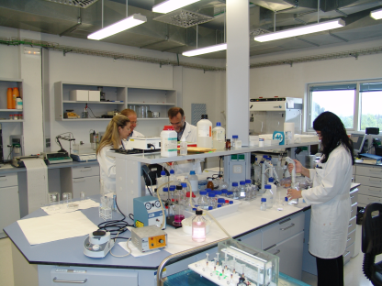
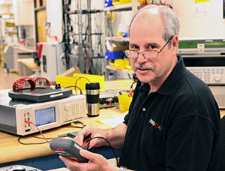
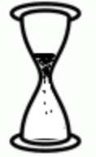
Repeatability
refers to the closeness of agreement between successive measurements of the same item carried out under the same conditions — same method, same operator, same equipment, same location, and over a short period of time.
Same measurement method
Same instrument
Ohmmeter
Same place
Same operator
repetition within a short period of time

Slide 16
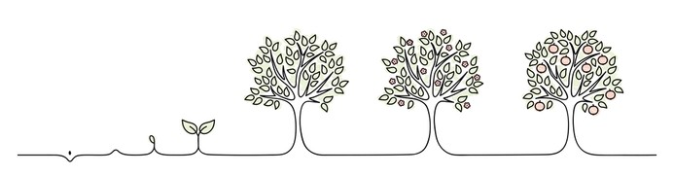
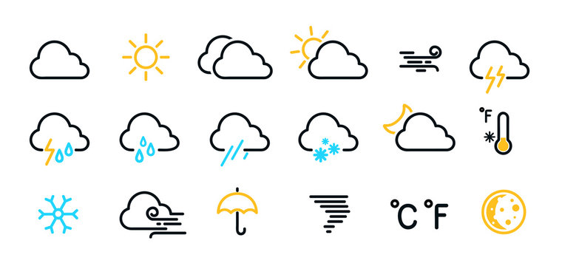
Challenges in Agriculture
NDVI
Temporal sampling of vegetation indexes requires a good reproducibility against changing solar irradiance, weather and field conditions
This can only be obtained if the measurement procedure refers to a standard.
Crop lifecycle

Slide 17
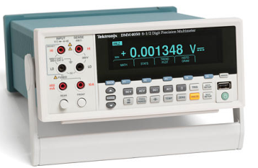
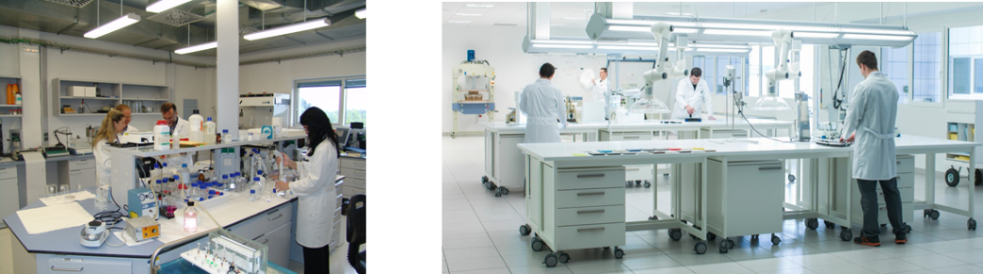
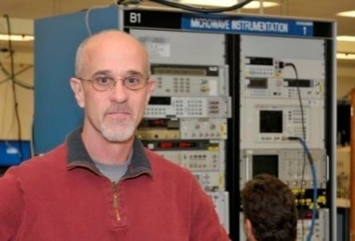
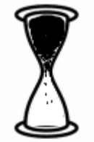
Reproducibility
describes the ability to obtain similar results when a study or experiment is repeated under different conditions.
volt ampere
Different measurement method
Different instruments
Different operator
Different place
Different time

Slide 18
Research gaps in UAV-PA
Existing methods rely heavily on empirical calibration or simple sensor-based corrections.
Limited integration of physics-based modeling (solar irradiance, atmospheric effects, sensor characteristics, surface reflectance).
The contribution of uncertainties arising from variations in illumination, sensor characteristics, and surface properties is rarely quantified.
Shadows and occluded areas remain inadequately addressed.
Validation against reference instruments is often missing.
Liu, X., Yang, F., Wei, H., & Gao, M. (2022). Shadow removal from UAV images based on color and texture equalization compensation of local homogeneous regions. Remote Sensing, 14(11), 2616. https://doi.org/10.3390/rs14112616

Slide 19
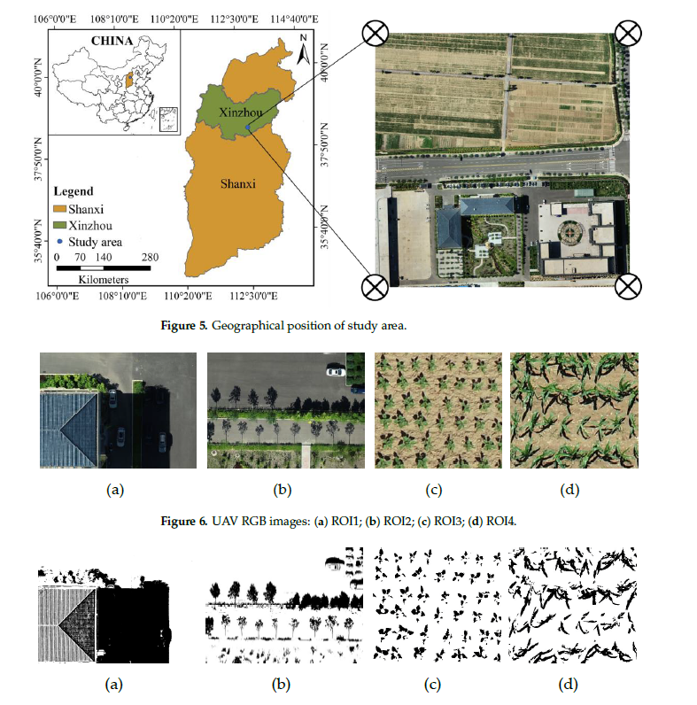
Shadows and occluded areas remain inadequately addressed.
This setup allowed them to evaluate how shadows from buildings, trees, and other structures influence reflectance values in both vegetated and non-vegetated areas, which is critical for accurate surface reflectance and vegetation index estimation.
Figure 5 – Geographical position of study area:
1- Shows the location in Shanxi Province, China, with Xinzhou City marked as the study area.
2- The right panel provides a UAV orthophoto showing mixed urban and agricultural zones, where images were collected for analysis.
Liu, X., Yang, F., Wei, H., & Gao, M. (2022). Shadow removal from UAV images based on color and texture equalization compensation of local homogeneous regions. Remote Sensing, 14(11), 2616. https://doi.org/10.3390/rs14112616
Notes:
This slide illustrates the study area used in their shadow analysis.
In Figure 5, they show the geographical location in Shanxi Province, China, with Xinzhou City marked as the specific study region. This location was chosen because it includes both urban structures and agricultural fields, which provide a good mix of surfaces for analyzing shadow effects in UAV imagery.
On the right side, the authors present a UAV orthophoto of the study site. It clearly shows mixed urban and agricultural zones, where UAV images were captured for testing their shadow removal and compensation techniques.
This setup allowed them to evaluate how shadows from buildings, trees, and other structures influence reflectance values in both vegetated and non-vegetated areas, which is critical for accurate surface reflectance and vegetation index estimation.

Slide 20
Shadows and occluded areas remain inadequately addressed.
The bottom row displays the shadow masks that correspond to each region of interest. These masks highlight the detected shadowed areas that were later used in the shadow compensation and correction process.
By separating shadows in both urban and agricultural scenes, they were able to assess how effectively the model could identify and correct varying shadow patterns under different surface and lighting conditions.
This step is essential for improving reflectance accuracy and ensuring reliable vegetation and surface analysis from UAV imagery.
Figure 6 – UAV RGB images and corresponding shadow masks:
(a) ROI1 and (b) ROI2: Urban environments, including rooftops, roads, and vegetation strips.
(c) ROI3 and (d) ROI4: Agricultural fields, mainly with crops showing irregular, fragmented shadows.
Liu, X., Yang, F., Wei, H., & Gao, M. (2022). Shadow removal from UAV images based on color and texture equalization compensation of local homogeneous regions. Remote Sensing, 14(11), 2616. https://doi.org/10.3390/rs14112616
Notes:
This slide presents UAV RGB images and their corresponding shadow masks, which illustrate how shadows were identified and analyzed in their study.
In Figure 6, the authors defined four regions of interest, or ROIs.
Panels (a) and (b) correspond to urban environments, including rooftops, roads, and vegetation strips.
Panels (c) and (d) represent agricultural fields, mainly showing crop areas with irregular and fragmented shadows.
The bottom row displays the shadow masks that correspond to each region of interest. These masks highlight the detected shadowed areas that were later used in the shadow compensation and correction process.
By separating shadows in both urban and agricultural scenes, they were able to assess how effectively the model could identify and correct varying shadow patterns under different surface and lighting conditions.
This step is essential for improving reflectance accuracy and ensuring reliable vegetation and surface analysis from UAV imagery.

Slide 21
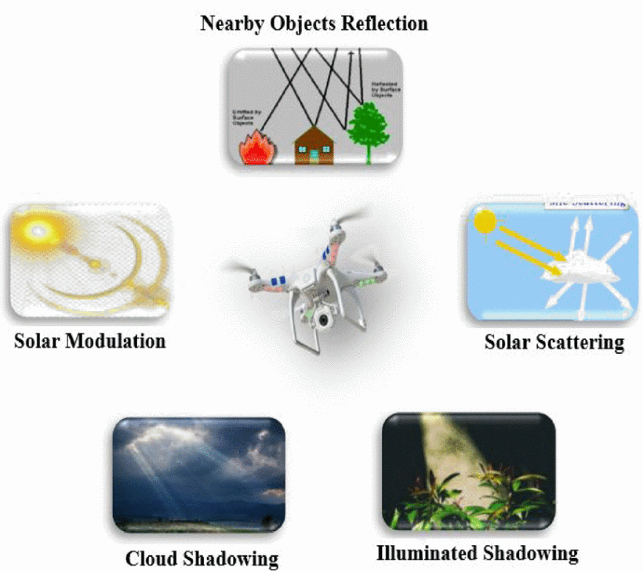
Uncertainty sources affecting UAV spectral imaging
such as reflections from buildings, trees, or bright surfaces, can introduce unwanted radiance into the image, distorting the true surface reflectance.
involves light being scattered by air molecules or aerosols, which alters the direction and intensity of reflected signals captured by the UAV sensors.
Together, these uncertainty sources affect the stability and reliability of UAV-derived spectral indices, emphasizing the need for proper correction models and calibration methods in precision agriculture applications.
refers to variations in solar radiation intensity due to time of day or atmospheric conditions.
occurs when areas receive indirect or diffuse light, making it difficult to distinguish between shaded and lit regions.
where transient clouds partially block sunlight, causing inconsistent illumination across the scene.
Khalesi, F., Daponte, P., De Vito, L., Picariello, F., & Tudosa, I. (2022). UAV in Precision Agriculture: A Preliminary Assessment of Uncertainty for Vegetation Health Index. IEEE Workshop on Metrology for Agriculture and Forestry (MetroAgriFor), Perugia, Italy, pp. 94–99. https://doi.org/10.1109/MetroAgriFor55389.2022.9964645
Notes:
This slide illustrates the main sources of uncertainty that affect UAV spectral imaging, as discussed by Khalesi and colleagues in 2022.
They identify several environmental and physical factors that can influence the accuracy of UAV-based spectral measurements.
At the top left, solar modulation refers to variations in solar radiation intensity due to time of day or atmospheric conditions.
Solar scattering, shown on the right, involves light being scattered by air molecules or aerosols, which alters the direction and intensity of reflected signals captured by the UAV sensors.
Another key factor is cloud shadowing, where transient clouds partially block sunlight, causing inconsistent illumination across the scene.
Illuminated shadowing occurs when areas receive indirect or diffuse light, making it difficult to distinguish between shaded and lit regions.
Additionally, nearby object reflection, such as reflections from buildings, trees, or bright surfaces, can introduce unwanted radiance into the image, distorting the true surface reflectance.
Together, these uncertainty sources affect the stability and reliability of UAV-derived spectral indices, emphasizing the need for proper correction models and calibration methods in precision agriculture applications.

Slide 22
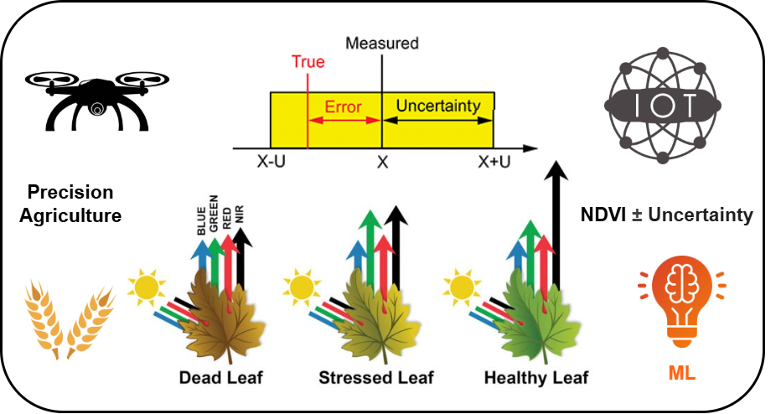
Research gaps
Necessity of integrating metrological principles into PA for:
Reliable measurement under uncontrolled environmental conditions
Adaptive models that account for inherent uncertainties in data collection and analysis
Notes:
Data accuracy affected by sensor limitations and environmental factors
Need for traceability and uncertainty quantification in measurements
Diverse technologies: UAVs, IoT, satellites – each with pros and cons
High costs and complexity limit adoption by small-scale farmers
Develop low-cost, accurate sensing solutions for PA
Quantify and manage measurement uncertainties effectively
Integrate AI/ML techniques for crop health monitoring and disease detection
Support sustainable, data-driven decision-making in agriculture

Slide 23

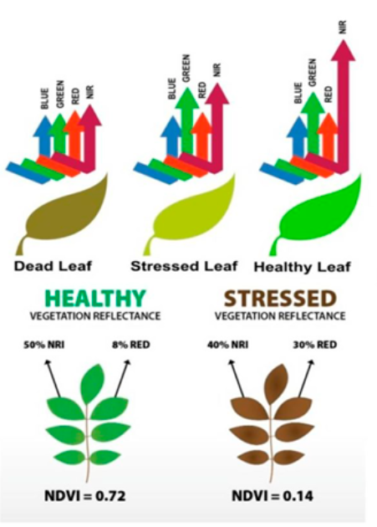
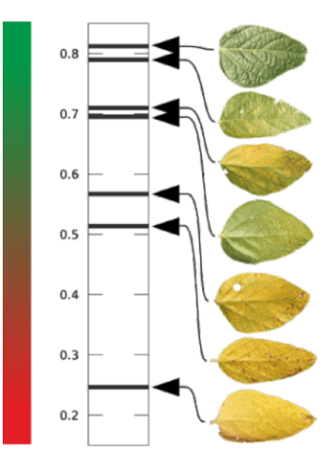
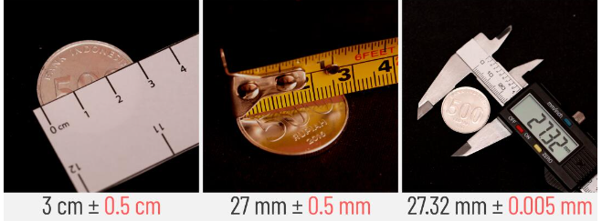


NDVI and the importance of measuring its uncertainty
$$NDVI=0.7$$
$$NDVI=\frac{\left(ρ(NIR)−ρ(R)\right)}{\left(ρ(NIR)+ρ(R)\right)}$$
± Uncertainty
Uncertainty:
Non-negative parameter characterizing the dispersion of the quantity values being attributed to a measurand, based on the information used
Evaluating and expressing the quality of a measurement result

Slide 24


Assessment of Measurement Uncertainty (1)
GUM (Guide to the expression of Uncertainty in Measurement)
Type A
Type B
Statistical analysis of a series of observations
Scientific judgment based on all available information (e.g. multispectral camera data sheet) on inputs’ possible variability
$$NDVI=\frac{\left(ρ(NIR)−ρ(R)\right)}{\left(ρ(NIR)+ρ(R)\right)}$$
$NDVI$ is an Indirect Measurement
Law of Uncertainty Propagation
Evaluation of measurement data-Guide to the expression of uncertainty in measurement, JCGM 100:2008. 2008

Slide 25





Assessment of Measurement Uncertainty NDVI (2)
$$\left.Y=f(X_{1},X_{2},…,X_{N}\right)$$
Uncorrelated
Correlated
$$u_{c}^{2}\left(y\right)=\sum_{i=1}^{N}{(}{\frac{∂f}{{∂x}_{i}})}^{2}.u^{2}(x_{i})$$
$$u_{cr}^{2}\left(y\right)=u_{c}^{2}\left(y\right)+2 .\sum_{i=1}^{N−1}{\sum_{j=i+1}^{N}{(\frac{∂f}{{∂x}_{i}}}).(\frac{∂f}{{∂x}_{j}}}).u(x_{i},x_{j})$$
NDVI
NDVI
$u_{c}^{2}\left(NDVI\right)= {[2.\frac{R}{{\left(R+NIR\right)}^{2}}]}^{2}.u^{2}\left(NIR\right)$ +${[−2.\frac{NIR}{{\left(R+NIR\right)}^{2}}]}^{2}{.u}^{2}\left(R\right)$
$u_{cr}^{2}\left(NDVI\right)= u_{c}^{2}\left(NDVI\right)$+ 2. $\left(2.\frac{R}{{\left(R+NIR\right)}^{2}}\right). \left(−2.\frac{NIR}{{\left(R+NIR\right)}^{2}}\right). u\left(R,NIR\right)$

Slide 26
Possible uncertainty sources in NDVI measurements:
Possible uncertainty sources in NDVI measurements:
  solar irradiance
  nominal working wavelength of the camera
  SNR of the camera
  variability of the measurand within each considered leaf state
Notes:
the camera SNR, the camera nominal wavelength, and the

Slide 27

Sensitivity analysis
Monte Carlo Simulation (100 Trials)
Khalesi, F.; Ahmed, I.; Daponte, P.; Picariello, F.; De Vito, L.; Tudosa, I.
The Uncertainty Assessment by the Monte Carlo Analysis of NDVI Measurements Based on Multispectral UAV Imagery.
Sensors 2024, 24, 2696. https://doi.org/10.3390/s24092696

Slide 28







Sensitivity analysis
Monte Carlo Simulation (100 Trials)
$$L_{i}\left(λ\right)$$
$$L_{S}\left(λ\right)$$
Atmospheric transmission in the return path from the vegetation to the UAV was neglected, assuming a low UAV flight altitude
Khalesi, F.; Ahmed, I.; Daponte, P.; Picariello, F.; De Vito, L.; Tudosa, I. The Uncertainty Assessment by the Monte Carlo Analysis of NDVI Measurements Based on Multispectral UAV Imagery. Sensors 2024, 24, 2696. https://doi.org/10.3390/s24092696
Notes:
The process \acs{MCS} method involves several key steps: (1) establishing a model equation for the measurand based on the influence of individual parameters; (2) identifying the significant sources of uncertainty; (3) determining the probability density functions corresponding to each identified uncertainty source; (4) selecting the number of Monte Carlo trials; and (5) calculating the results by applying the model equation to the measurand~\cite{mahmoud2017comparison,khalesi2024uncertainty}.
\acs{MCS} employs random sampling to estimate the potential outcomes of uncertain events or systems. By generating multiple scenarios with randomly assigned parameter values, \acs{MCS} simulates the probability distribution of various outcomes. This method is particularly valuable for assessing risk and making informed decisions in the presence of unpredictable factors~\cite{CHEN2013106,khalesi2024uncertainty}.

Slide 29




Evaluating uncertainty of NDVI
$u_{c}^{2}\left(NDVI\right)= {[2.\frac{ρ(R)}{{\left(ρ(R)+ρ(NIR)\right)}^{2}}]}^{2}.u^{2}\left(NIR\right)$ +${[−2.\frac{ρ(NIR)}{{\left(ρ(R)+ρ(NIR)\right)}^{2}}]}^{2}{.u}^{2}\left(R\right)$
$$u_{W}\left(λ\right)= \left(\frac{∂E_{W}\left(λ\right)}{∂λ_{W}}\right).(\frac{∆λ_{W}}{\sqrt{3}})$$
$$∆λ_{W }:\text{R}\text{epresents} \text{the} \text{tolerance} \text{in} \text{camera} \text{wavelengths}$$
$$BIR\left(λ\right)= \int_{λ−∆λ}^{λ+∆λ}{L_{S}\left(λ\right)}dλ$$
$BIR(λ)$: The area of the material’s spectral reflected light
captured by the camera at its nominal wavelength
Value measured by the camera
Khalesi, F.; Ahmed, I.; Daponte, P.; Picariello, F.; De Vito, L.; Tudosa, I. The Uncertainty Assessment by the Monte Carlo Analysis of NDVI Measurements Based on Multispectral UAV Imagery. Sensors 2024, 24, 2696. https://doi.org/10.3390/s24092696

Slide 30
Evaluating uncertainty of NDVI
In the digitalization stage, uncertainty is modeled through:
  Quantization (e.g. 8-bit color quantization)
  Noise (e.g. 50 dB SNR)
Khalesi, F.; Ahmed, I.; Daponte, P.; Picariello, F.; De Vito, L.; Tudosa, I. The Uncertainty Assessment by the Monte Carlo Analysis of NDVI Measurements Based on Multispectral UAV Imagery. Sensors 2024, 24, 2696. https://doi.org/10.3390/s24092696

Slide 31

ADDL = atmosphere dry–clear and dry leaf,
ADFL = atmosphere dry–clear and fresh leaf
AHDL = atmosphere humid–hazy and dry leaf,
AHFL = atmosphere humid–hazy and fresh leaf,
AMDL= atmosphere mixed for dry leaf
AMFL = atmosphere mixed for fresh leaf.
The threshold for distinguishing between dry and fresh leaf is depending on the atmospheric conditions
Khalesi, F.; Ahmed, I.; Daponte, P.; Picariello, F.; De Vito, L.; Tudosa, I. The Uncertainty Assessment by the Monte Carlo Analysis of NDVI Measurements Based on Multispectral UAV Imagery. Sensors 2024, 24, 2696. https://doi.org/10.3390/s24092696

Slide 32


Testing Model, Result (2)
Distinguishing between dry and fresh leaves based on just the given NDVI values is not reliable
LSB Uncertainty, approximately within range 0.03 to 0.1 for both dry and fresh vegetation
The estimated NDVI : (0.759, 0.869) has overlaps with dry type
Notes:
LSB stands for Lower Sideband (not Least Significant Bit)

Slide 33


Why evaluate uncertainty
SIGNIFICANCE OF A MEASUREMENT
Measurement of body temperature before and after drug administration
Before: 38.2 ̊C After: 38.4 ̊C
Is the temperature increase significant?
To answer the question we need to look at the measurement uncertainties !!!

Slide 34
Why evaluate uncertainty
SIGNIFICANCE OF A MEASUREMENT
Before: 38.2 ̊C After: 38.4 ̊C
Is the temperature increase significant?
(38.2±0.5) ̊C (38.4 ±0.5) ̊C
not significant
38.2
38.4
too much uncertainty makes the result unusable
37.7
38.7
37.9
38.9
(38.2±0.01) ̊C (38.4 ±0.01) ̊C
significant
38.2
38.4
38.19
38.21
38.39
38.41

Slide 35
not significant
ADDL = atmosphere dry–clear and dry leaf,
ADFL = atmosphere dry–clear and fresh leaf
AHDL = atmosphere humid–hazy and dry leaf,
AHFL = atmosphere humid–hazy and fresh leaf,
AMDL= atmosphere mixed for dry leaf
AMFL = atmosphere mixed for fresh leaf (AMFL).
too much uncertainty makes the result unusable
The threshold for distinguishing between dry and fresh leaf is depending on the atmospheric conditions
Khalesi, F.; Ahmed, I.; Daponte, P.; Picariello, F.; De Vito, L.; Tudosa, I. The Uncertainty Assessment by the Monte Carlo Analysis of NDVI Measurements Based on Multispectral UAV Imagery. Sensors 2024, 24, 2696. https://doi.org/10.3390/s24092696

Slide 36
Radiometric compensation
In the UAV-PA case, the lack of significance was due to the dependence of NDVI on the atmospheric conditions
Radiometric compensation aims to adjust the NDVI values to make them independent on atmospheric conditions
Notes:
F. Khalesi, R. Martínez-Peña, S. Vélez Martín, J. Valente, F. Picariello, L. De Vito, P. Daponte, "Radiometric Compensation Method for NDVI Measurement Using Emulated Targets, " submitted for publication to IEEE Transactions on Instrumentation and Measurement

Slide 37


DJI Inc., “Mavic 3M image processing guide,” 2025, last accessed 06 February 2025. [Online].
Available: https://dl.djicdn.com/downloads/DJI Mavic 3 Enterprise/20230829/Mavic 3M Image Processing Guide EN.pdf

Slide 38

NDVI Evaluation with Radiometric Compensation
Radiometric compensation allows to adjust the NDVI values to make them less dependent on atmospheric conditions
Traditional methods for radiometric compensation include the use of reflective targets of known reflectivity
A radiometric compensation method using emulated radiometric targets, whose behavior is evaluated starting from satellite spectral solar irradiance data and models for atmospheric transmission was proposed:
F. Khalesi, R. Martínez-Peña, S. Vélez Martín, J. Valente, F. Picariello, L. De Vito, P. Daponte, "Radiometric Compensation Method for NDVI Measurement Using Emulated Targets, " submitted for publication to IEEE Transactions on Instrumentation and Measurement
Notes:
A key contribution of this study is the development of a radiometric compensation method by using the DJI white paper~\cite{webDJI_ImageProcess}. This method emulated reflectance panels constructed from Permaflect sheets with reflectance values ranging from 5\% to 94\% (this approach enables the development of an effective radiometric compensation method across diverse lighting and surface scenarios), and validating the model useing a real reference panel under field conditions.
validating the model useing a real reference panel under field conditions.

Slide 39



Radiometric compensation
Permaflect
Regression curve
The specifications of real radiometric targets have been considered
$$L_{i}\left(λ\right)$$
Measured radiance
$$L_{S}\left(λ\right)$$
Target reflectance
10/18/2025

Slide 40






Emulated targets
Solar radiance
$$L_{i}\left(λ\right)$$
$$L_{S}\left(λ\right)$$
$$BIR$$
Atmosphere transmission
Target reflection
Camera sensor
Digitalization
$$BIR$$
Radiometric Compensation
Output of Monte Carlo Simulation
Reflected spectral radiance by the emulated targets is evaluated using the same data and models used previously and the target spectral reflectance
F. Khalesi, R. Martínez-Peña, S. Vélez Martín, J. Valente, F. Picariello, L. De Vito, P. Daponte, "Radiometric Compensation Method for NDVI Measurement Using Emulated Targets, " submitted for publication to IEEE Transactions on Instrumentation and Measurement

Slide 41

Compensated vs non-compensated NDVI
Threshold
Radiometric compensation is effective in aligning distributions with the same health state even acquired in different atmospheric conditions
Healthy and Dry leave conditions are now separable
NDVI Values,
Non Compensated,
NDVI Values,
Compensated

Slide 42










Experimental validation in cooperation with CSIC (Spain)
(a)
(b)
(c)
(d)
Pistachio field (Sept 9, 2024),
AIRINOV calibration target,
(c) DJI Mavic 3 Multispectral UAV,
(d) Image processing software (Agisoft Metashape, R, QGIS),
(e) CSV files,
(f) Orthomosaic TIFF output,
(g) FieldScout CM 1000 NDVI Meter
(h) Excel file of reference NDVI values.
(i) NDVI compensation method by emulated targets
(g)
(f)
(h)
+
(e)
(i)
Reference
NDVI Dataset
Multispectral Images and Image Processing
F. Khalesi, R. Martínez-Peña, S. Vélez Martín, J. Valente, F. Picariello, L. De Vito, P. Daponte, "Radiometric Compensation Method for NDVI Measurement Using Emulated Targets, " submitted for publication to IEEE Transactions on Instrumentation and Measurement

Slide 43


Flight Planning: The Mavic 3
Calibration Target Placement
(b)
(c)
(d)
Find Tree (ROI)
Image Import in Metashape and Preprocessing:
Uncorrected version, the images were used directly without any modifications.
Corrected version, the images were used after scaling them based on coefficients (using the reference panel, irradiance data from the sun sensor, a vignetting compensation modeled by a third-order polynomial in Agrisoft Metashape and camera’s white paper)
F. Khalesi, R. Martínez-Peña, S. Vélez Martín, J. Valente, F. Picariello, L. De Vito, P. Daponte, "Radiometric Compensation Method for NDVI Measurement Using Emulated Targets, " submitted for publication to IEEE Transactions on Instrumentation and Measurement
Notes:
Flight Planning: The Mavic 3 Multispectral UAV
Calibration Target Placement: The AIRINOV panel
Image Import in Metashape and Preprocessing:
In the uncorrected version, the images were used directly without any modifications.
In the corrected version, the images were used after scaling them based on coefficients (using the reference panel, irradiance data from the sun sensor, and a vignetting compensation modeled by a third-order polynomial)
Image Alignment and Point Cloud Generation
Orthomosaic Generation
Digital Surface Model (DSM) : The DSM represented the elevation of all features in the scene, including the ground, vegetation, and any structures. Height values were interpolated, and compensations were applied to enhance model accuracy.
Canopy Height Model (CHM) Creation: To extract the canopy height, a Digital Terrain Model (DTM) was created by filtering out vegetation and structures, leaving only the bare ground elevation. The Canopy Height Model (CHM) was then obtained by subtracting the DTM from the DSM, effectively isolating the canopy height above ground level.
----------------
Canopy Height Extraction Using DSM and DTM
Digital Surface Model (DSM):
The DSM represents the elevation of the Earth's surface including all objects such as:
Trees
Buildings
Vegetation
Digital Terrain Model (DTM):
This model captures only the bare ground elevation, with all non-ground features removed through filtering and interpolation techniques.
Canopy Height Model (CHM):
The CHM is computed as:
CHM=DSM−DTM\text{CHM} = \text{DSM} - \text{DTM}CHM=DSM−DTM This operation isolates the height of vegetation (canopy) above ground level by subtracting the ground elevation (DTM) from the surface elevation (DSM).
Interpretation of the Figure:
The figure visually demonstrates that the DSM includes both terrain and canopy height.
By removing (subtracting) the terrain component (DTM), the actual canopy height is revealed in the resulting CHM.

Slide 44

Find Tree (ROI) - CHM
(f)
Digital Surface Model (DSM) : The DSM represented the elevation of all features in the scene, including the ground, vegetation, and any structures. Height values were interpolated, and compensations were applied to enhance model accuracy.
Canopy Height Model (CHM) Creation: To extract the canopy height, a Digital Terrain Model (DTM) was created by filtering out vegetation and structures, leaving only the bare ground elevation. The Canopy Height Model (CHM) was then obtained by subtracting the DTM from the DSM, effectively isolating the canopy height above ground level.
CHM=DSM−DTM
F. Khalesi, R. Martínez-Peña, S. Vélez Martín, J. Valente, F. Picariello, L. De Vito, P. Daponte, "Radiometric Compensation Method for NDVI Measurement Using Emulated Targets, " submitted for publication to IEEE Transactions on Instrumentation and Measurement
Notes:
Flight Planning: The Mavic 3 Multispectral UAV
Calibration Target Placement: The AIRINOV panel
Image Import in Metashape and Preprocessing:
In the uncorrected version, the images were used directly without any modifications.
In the corrected version, the images were used after scaling them based on coefficients (using the reference panel, irradiance data from the sun sensor, and a vignetting compensation modeled by a third-order polynomial)
Image Alignment and Point Cloud Generation
Orthomosaic Generation
Digital Surface Model (DSM) : The DSM represented the elevation of all features in the scene, including the ground, vegetation, and any structures. Height values were interpolated, and compensations were applied to enhance model accuracy.
Canopy Height Model (CHM) Creation: To extract the canopy height, a Digital Terrain Model (DTM) was created by filtering out vegetation and structures, leaving only the bare ground elevation. The Canopy Height Model (CHM) was then obtained by subtracting the DTM from the DSM, effectively isolating the canopy height above ground level.
----------------
Canopy Height Extraction Using DSM and DTM
Digital Surface Model (DSM):
The DSM represents the elevation of the Earth's surface including all objects such as:
Trees
Buildings
Vegetation
Digital Terrain Model (DTM):
This model captures only the bare ground elevation, with all non-ground features removed through filtering and interpolation techniques.
Canopy Height Model (CHM):
The CHM is computed as:
CHM=DSM−DTM\text{CHM} = \text{DSM} - \text{DTM}CHM=DSM−DTM This operation isolates the height of vegetation (canopy) above ground level by subtracting the ground elevation (DTM) from the surface elevation (DSM).
Interpretation of the Figure:
The figure visually demonstrates that the DSM includes both terrain and canopy height.
By removing (subtracting) the terrain component (DTM), the actual canopy height is revealed in the resulting CHM.

Slide 45



Find Leaf Area (1)
Extracted Map
Orthomosaic image in QGIS
Notes:
Load Data in QGIS: Open Orthomosaic and NDVI TIFF files in QGIS (v3.38).
Initial NDVI Inspection: Select random pixels to verify if NDVI values align with tree leaves. Observed mismatch (e.g., values like 0.44 and 0.94).
NDVI Thresholding: Apply NDVI threshold of 0.50–0.85 (determined manually) to isolate leaf pixels.
Green Band Filtering: Extract reflectance values from manually selected leaf areas and apply a green band threshold of 2000–40000 DN.
Layer Integration: Multiply filtered green band with NDVI-CHM layer to emphasize vegetated canopy areas.
R and NIR Extraction: Extract R and NIR values from the resulting image; visualize in respective maps.
Histogram Analysis: Analyze reflectance distributions, which follow a Gaussian pattern.
Range R and NIR Identification of Leaf: Define leaf reflectance ranges:
R band: 2700–5700
NIR band: 15500–21500
Normalization: Apply z-score normalization for September 2. Use mean and standard deviation to adjust ranges for other dates.
Pixel Selection for Leaf: Extract pixels within defined R and NIR ranges to isolate leaf-covered regions for each date.

Slide 46


Find Leaf Area (2)
Red Band
R and NIR Extraction: Extract R and NIR values from the resulting image; visualize in respective maps.
Histogram Analysis: Analyze reflectance distributions, which follow a Gaussian pattern.
Range R and NIR Identification of Leaf: Define leaf reflectance ranges:
  R band: 2700–5700
  NIR band: 15500–21500
Normalization: Apply z-score normalization for September 2. Use mean and standard deviation to adjust ranges for other dates.
Pixel Selection for Leaf: Extract pixels within defined R and NIR ranges to isolate leaf-covered regions for each date.
NIR Band
Notes:
Load Data in QGIS: Open Orthomosaic and NDVI TIFF files in QGIS (v3.38).
Initial NDVI Inspection: Select random pixels to verify if NDVI values align with tree leaves. Observed mismatch (e.g., values like 0.44 and 0.94).
NDVI Thresholding: Apply NDVI threshold of 0.50–0.85 (determined manually) to isolate leaf pixels.
Green Band Filtering: Extract reflectance values from manually selected leaf areas and apply a green band threshold of 2000–40000 DN.
Layer Integration: Multiply filtered green band with NDVI-CHM layer to emphasize vegetated canopy areas.
R and NIR Extraction: Extract R and NIR values from the resulting image; visualize in respective maps.
Histogram Analysis: Analyze reflectance distributions, which follow a Gaussian pattern.
Range R and NIR Identification of Leaf: Define leaf reflectance ranges:
R band: 2700–5700
NIR band: 15500–21500
Normalization: Apply z-score normalization for September 2. Use mean and standard deviation to adjust ranges for other dates.
Pixel Selection for Leaf: Extract pixels within defined R and NIR ranges to isolate leaf-covered regions for each date.

Slide 47



Results of the Radiometric Compensation Method in Dry Atmosphere
Box plot of NDVI measurement by FieldScout CM 1000 NDVI Meter
Box plot of NDVI measurement by UAV, with compensation suggested by DJI Guide andAgisoft Metashape
Box plot of NDVI measurement by UAV, without compensation
(a)
(b)
The distribution of NDVI values computed from the R and NIR leaf reflectance within the ROI for Tree ID 1 on September 2, 4, 6, and 9 is presented. These values are evaluated using
the conventional method in Agisoft Metashape software before (a) and after (b) compensation.
(c) applying the proposed radiometric compensation method under dry-clear atmospheric conditions

Slide 48
Conclusions and Outlook
A complete workflow for NDVI evaluation from UAV multispectral imagery was established — integrating measurement uncertainty analysis according to metrological principles (GUM).
The proposed radiometric compensation method using emulated targets effectively minimized the effect of varying atmospheric conditions and improved NDVI reproducibility.
Comparative validation with ground reference instruments (FieldScout NDVI Meter) confirmed the reliability of compensated UAV data.
The approach demonstrates how measurement science can enhance the credibility of UAV-based vegetation monitoring and decision-making in precision agriculture.
Beyond NDVI, this methodology can be extended to other vegetation indices (NDMI, CWSI, etc.) and multi-sensor fusion frameworks, strengthening future precision farming systems.
The results underline the importance of standardized data acquisition, calibration, and uncertainty modeling in transforming UAV measurements into trusted scientific evidence.

Slide 49
Open Path to Young Researchers
The fusion of UAV technology, metrology, and precision agriculture offers vast opportunities for innovation.
Future progress depends on accurate measurements, standardized methods, and transparent uncertainty evaluation.
Young researchers can contribute by:
  Designing robust calibration and compensation techniques for UAV-based sensing.
  Developing AI-driven models that integrate spectral, spatial, and temporal data.
  Promoting open data and reproducible research in agricultural monitoring.
Collaboration across engineering, agriculture, and data science will shape the next generation of sustainable solutions.
“The open path awaits those ready to measure, model, and make a difference.”

Slide 50


Some informations
http://resourcecenter.ims.ieee.org/ims/product/education/IMSTUT0050
http://resourcecenter.ims.ieee.org/ims/product/education/IMSTUT0160

Slide 51


UAV Unisannio LAB
UAVs:
Hexarotor UAV with two embedded stereo cameras for stereo-vision;
Dj Phantom 4 Pro;
Intel® Aero Ready to Fly Drone;
Bebop 2 Parrot.
UAV sensors:
RPLIDAR A2M8 360° Laser Scanner;
2 x C94-M8P GPS RTK u-blox;
DronesBench - Test equipment for characterizing the efficiency of UAVs
http://lesim1.ing.unisannio.it/uav_unisannio_lab/

Slide 52

Ph.D. Course
A Ph.D. course supported by the IEEE Instrumentation & Measurement Society is available at the University of Sannio
Contents:
Introduction to drones;
The drone architecture;
The sensors for flight control including inertial and navigation sensors;
Data fusion algorithms for navigation;
The sensors used as payload, including LIDARs, visual cameras and thermal cameras.
Drone programming;
3D reconstruction by aerial photogrammetry.
Practical experiences with drones.
We can offer to your institution this course …contact us…

Slide 53

MetroAeroSpace
IEEE MetroAeroSpace 2026 / Madrid, Spain / July 1-3, 2026
Workshop Topics:
Electronic instrumentation for aerospace
Automatic test equipment for aerospace
Sensors and sensor systems for aerospace applications
Wireless sensor networks in aerospace
Attitude and heading reference systems
Monitoring systems in aerospace
Metrology for navigation and precise positioning
Sensors and Data Fusion Techniques for Avionics and Air Traffic Management
Flight Testing Instrumentation and Flight Test Techniques
www.metroaerospace.org

Slide 54

IEEE MetroAgriFor
https://www.metroagrifor.org/
Workshop Topics:
Sensor networking and integration;
Approaches and tools for measuring Food Quality;
Soil analysis, mapping and monitoring;
Crop analysis, mapping and monitoring;
Precision agriculture, forestry and livestock farming;
Measurements for agriculture, forestry and environment;
Agroclimatic measurements;
MetroAgriFor 2025: Bologna, Italy, October 28-30, 2025
MetroAgriFor 2026: Potsdam, Germany, November 9-11, 2026

Slide 55

Special Issues
Advances in UAV Sensing and Data Analytics for Precision Agriculture: https://www.mdpi.com/journal/sensors/special_issues/AAXPY203D7
Advanced UAV-Based Sensor Technologies: 2nd Edition: https://www.mdpi.com/journal/sensors/special_issues/JPMR8FHWP1

Slide 56


Thanks for Your Attention
Any Questions Please?
Email: daponte@unisannio.it

Slide 57

Sample of Leaf Selection
Figure – Leaf Image Segmentation Using Color-Based Seed Initialization
This figure illustrates the stepwise process of leaf region extraction for various crop species.
(a) Original RGB leaf images showing both healthy and diseased areas.
(b) Corresponding grayscale transformations highlighting leaf texture and vein structures.
(c) Initial segmentation results based on color-space thresholding and seed point localization.
(d) Final binary masks after refinement, showing precise separation of the leaf region from the background.
The results demonstrate that color-based seed initialization followed by thresholding in the Lab color space effectively isolates leaf regions across diverse species and lighting conditions, providing reliable input for subsequent disease classification.
Y. Kurmi and S. Gangwar, “A leaf image localization based algorithm for different crops disease classification,” Information Processing in Agriculture, vol. 9, no. 3, pp. 456–474, 2022, doi: 10.1016/j.inpa.2021.03.001.
Notes:
On this slide, they present an example of the leaf image segmentation process used for selecting the leaf region before disease classification.
The figure illustrates a color-based seed initialization method applied to different crop species.
In part (a), the authors show the original RGB images of leaves containing both healthy and diseased regions.
In (b), these images are converted to grayscale, which helps emphasize leaf texture and vein patterns.
Next, in (c), they show the initial segmentation results obtained using color-space thresholding and seed point localization — this step helps roughly identify the leaf boundaries.
Finally, in (d), they present the refined binary masks, showing accurate separation of the leaf area from the background.
This stepwise process ensures that only the relevant leaf region is extracted, minimizing background interference and lighting variations.
As a result, the segmented leaf images serve as clean and reliable inputs for subsequent disease detection and classification tasks.
This example is adapted from the work of Kurmi and Gangewar (2022), published in Information Processing in Agriculture, which demonstrates how color-based segmentation in the Lab* color space improves leaf isolation across species and lighting conditions.

